Slide 1
Hotel AI Chatbot Project
Jeremiah Dy
Project duration: 1 month (June 2025)

Slide 2
Project Overview
Create a microservice-based application that models a hotel website’s basic functionality, such as listing hotel information and allowing users to book stays
REST APIs for backend data processing and retrieval
React.js for frontend user experience
Use JWT authentication for stateless security, protecting secure content
Create an AI-powered chatbot that extends and integrates into the core website’s basic functionality, allowing the user a more human experience using NLP
Utilize vector embeddings and vector similarity search to extract relevant records from the database, regardless of dimensionality

Slide 3
Project Architecture
jwtsecurity
hotelchatbot
Languages: Java
Spring-boot
Maven
Spring Security
Spring Data JPA
PostgreSQL Database
JJWT
~~~~~~~~~~~~~~~~~~~~~~~~~~~~
This microservice serves the security portion of the project application.
Acting as a gateway to prevent unauthorized access of database information, this microservice issues and validate JWT tokens using RSA256 signing with public and private keys. All requests made by reactUI for database records must pass through jwtsecurity.
Upon user logout, the JWT token that was issued is stored in a “revokedList”, ensuring that the same token cannot be used again.
Languages: Java
Spring-boot
Maven
Spring Data JPA
Spring AI
Apache HTTP Client 5
PostgreSQL Database
pgvector
Jackson (library)
~~~~~~~~~~~~~~~~~~~~~~~~~~
This microservice serves the backend of the project application.
It accesses the PostgreSQL database to create and view hotel, room, and booking data. It also uses HTTP Client 5 to call OpenAI response and embedding models. Embedding data is stored and used for vector similarity search to find relevant entity data for a given human-language user query.
reactUI
Languages: Javascript
React.js
React-Bootstrap
webpack
babel
~~~~~~~~~~~~~~~~~~~~~~~~
This microservice serves the frontend of the project application.
It allows users to login/logout, view hotel and room data, and create bookings through HTTP requests to jwtsecurity. Upon login, a JWT token is assigned to the user and stored in sessionStorage, which will be used to authenticate all future requests to jwtsecurity.

Slide 4
Spring Security x JWT Authentication
jwtsecurity issues JWT token on login signed using a random UUID and a private key
Tokens are valid for one day (development purposes)
Frontend behavior
All content other than the Login/Register pages is secured behind a valid JWT token
Token is stored in sessionStorage, persists across page refresh, deleted on tab close
Secured content is wrapped in a React component that must receive a “successful authorization” from jwtsecurity, otherwise routes the user back to Login
Backend behavior
Default Spring-Security UsernamePasswordAuthenticationFilter is bypassed using custom JwtAuthenticationFilter

Slide 5
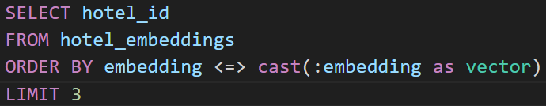
Vector Similarity Search
PostgreSQL database is configured with the pgvector extension
Upon saving hotel or hotel room data, a call is made to an OpenAI text-embedding model
The embedding data is stored in separate tables to avoid Hibernate mapping errors
Embedding model used: OpenAI’s text-embedding-3-small
When a user asks a question in human language, the query is formatted and embedded to compare cosine distance against the existing embeddings for that entity.
User query: “What hotels are near the beach?”
Formatted user query: “hotels near beach”
Embeddings table to search: Hotel Embeddings

Slide 6
Future Improvements
Conversation storage per user, allow user to view past chats (also clear stale chats)
CI/CD project flow, Dockerize microservices
More robust multi-lingual support (currently, user must prompt for a certain language first)
Greater hotel and hotel room data variety to test the effectiveness of vector similarity search
More robust data validation when submitting a booking request

Slide 7
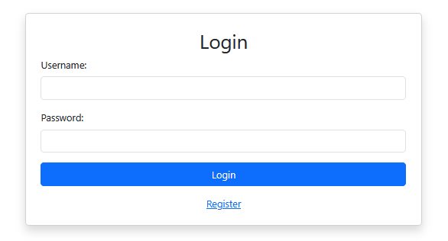
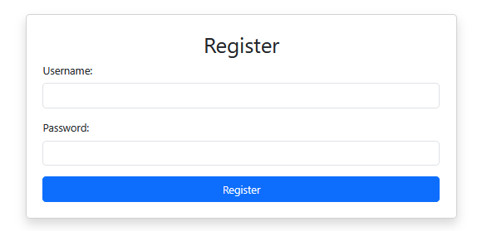
Login/Register

Slide 8
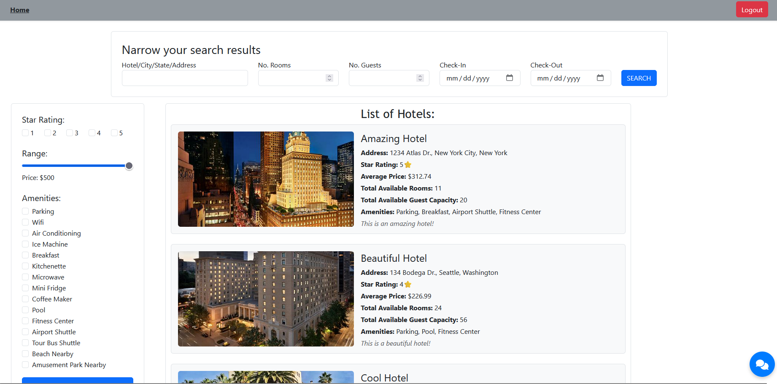
Homepage

Slide 9
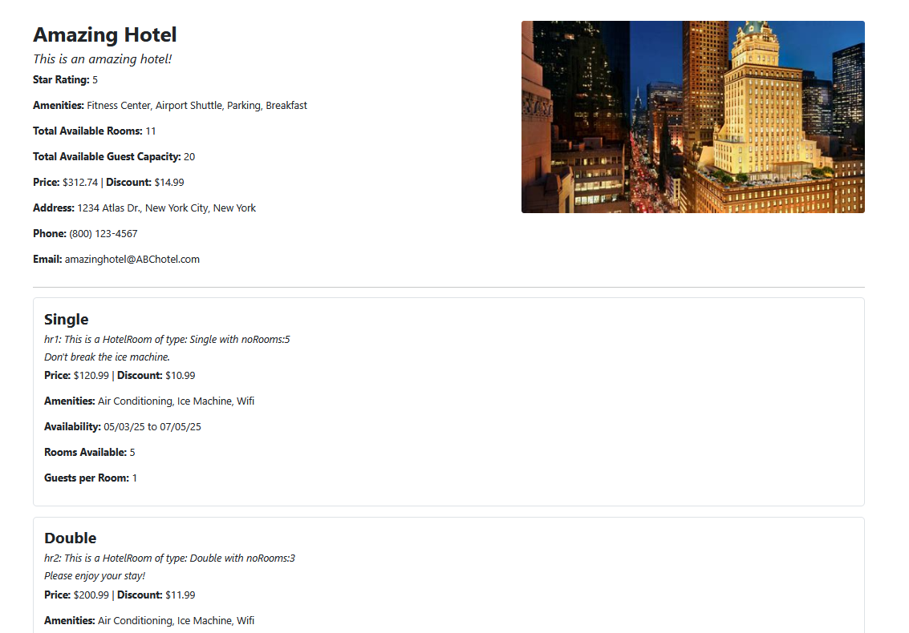
Hotel Details

Slide 10
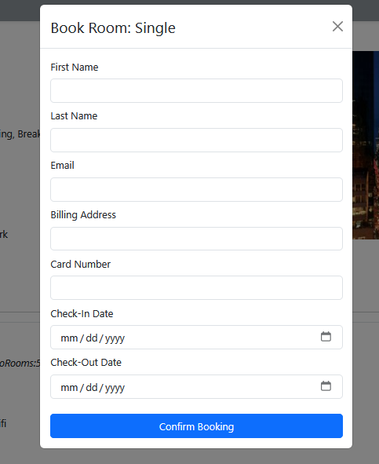
Booking popup

Slide 11
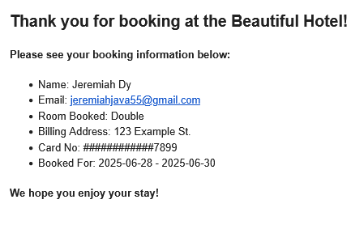
Booking Email Confirmation

